Slide 1
Manual Datasource
without validation
Create a new manual datasource - without validation
Not recommended

Slide 2
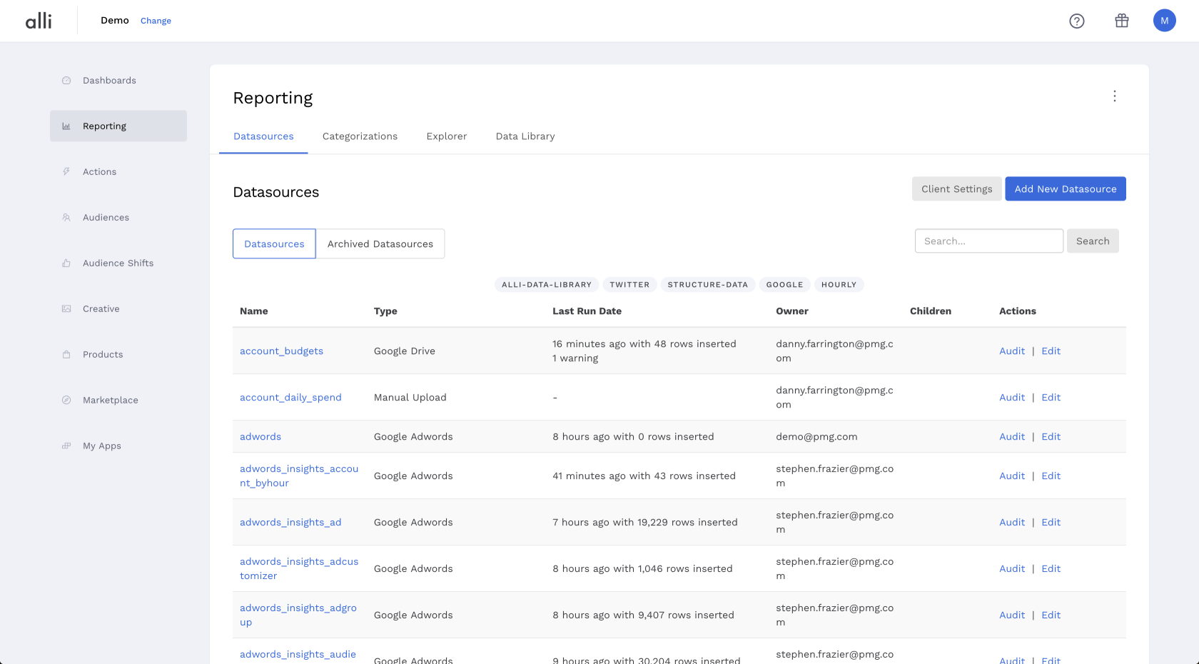
Step 1
First, find your client listed at the top left in the header, next to alli. For this tutorial, our client will be Demo.

Slide 3
Step 2
Click on the Reporting in the left sidebar

Slide 4
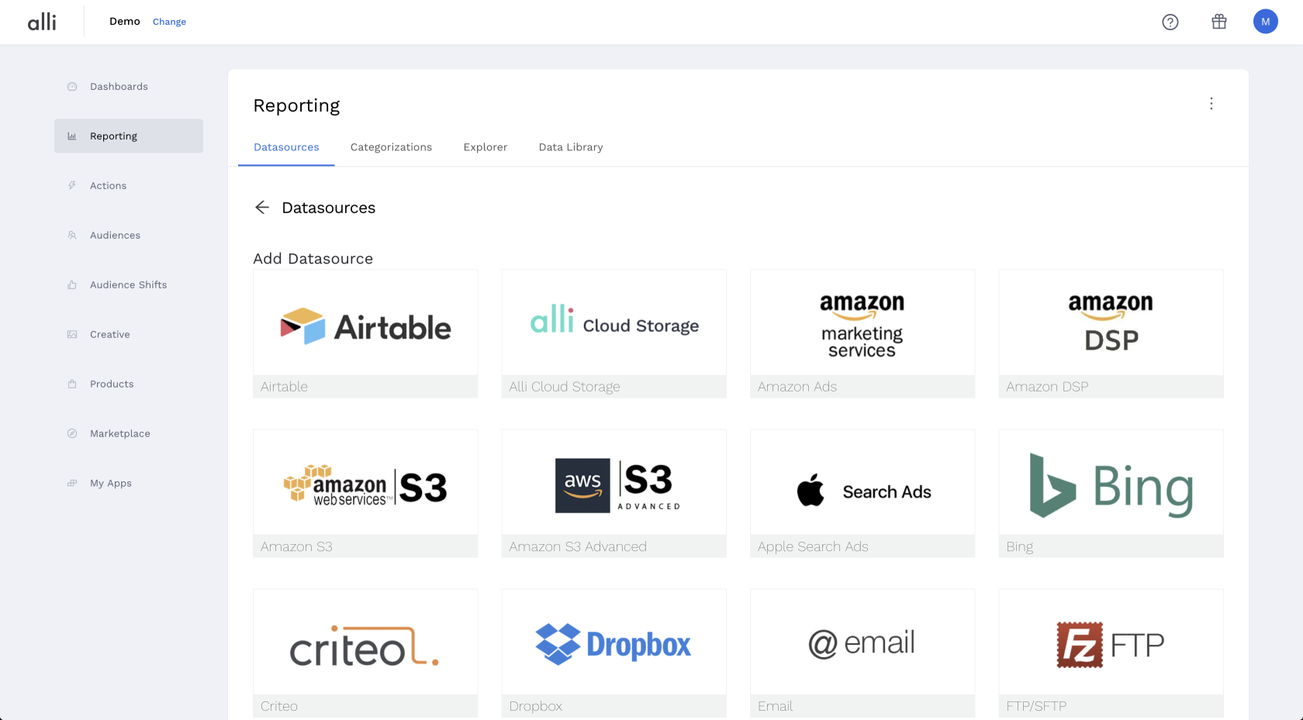
Step 3
Click on the blue Add New Datasource button in the top right corner. You will see a list of available partners to pull from.

Slide 5
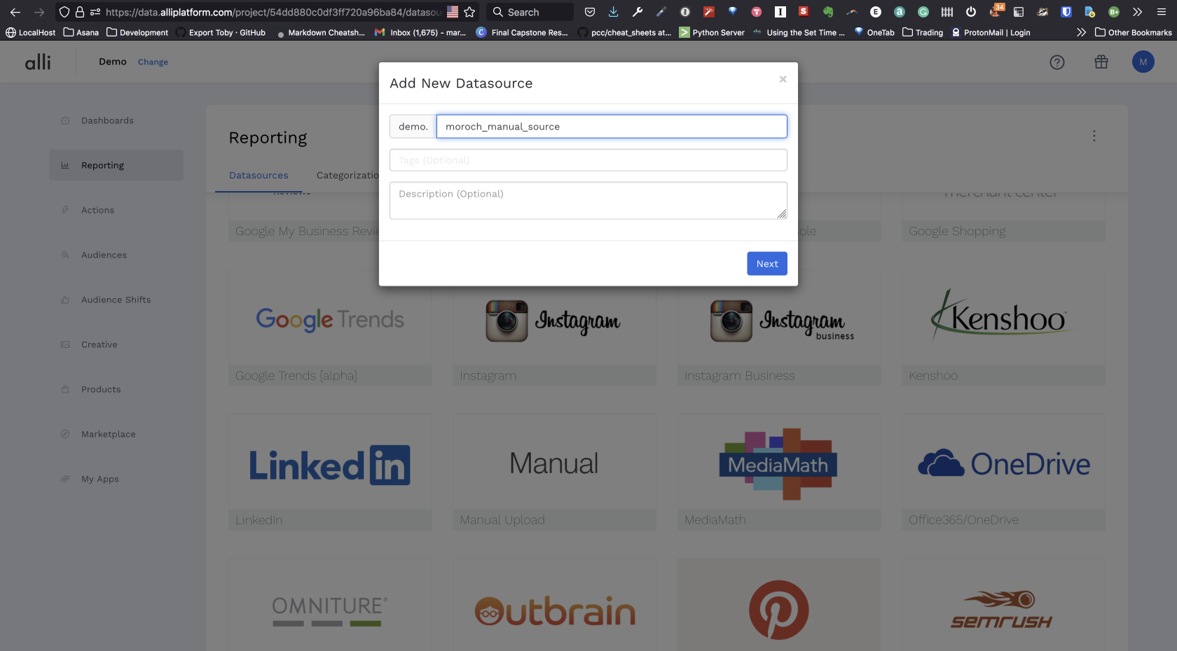
Step 5
After clicking on your datasource partner (manual in this case), you will see a pop-up box.

Slide 6
Step 6
You will need to name your datasource and you may use an underscore _ to separate words in the name. Any periods or other special characters will automatically default to an underscore.
You also have the ability to add optional tags and an optional description.

Slide 7
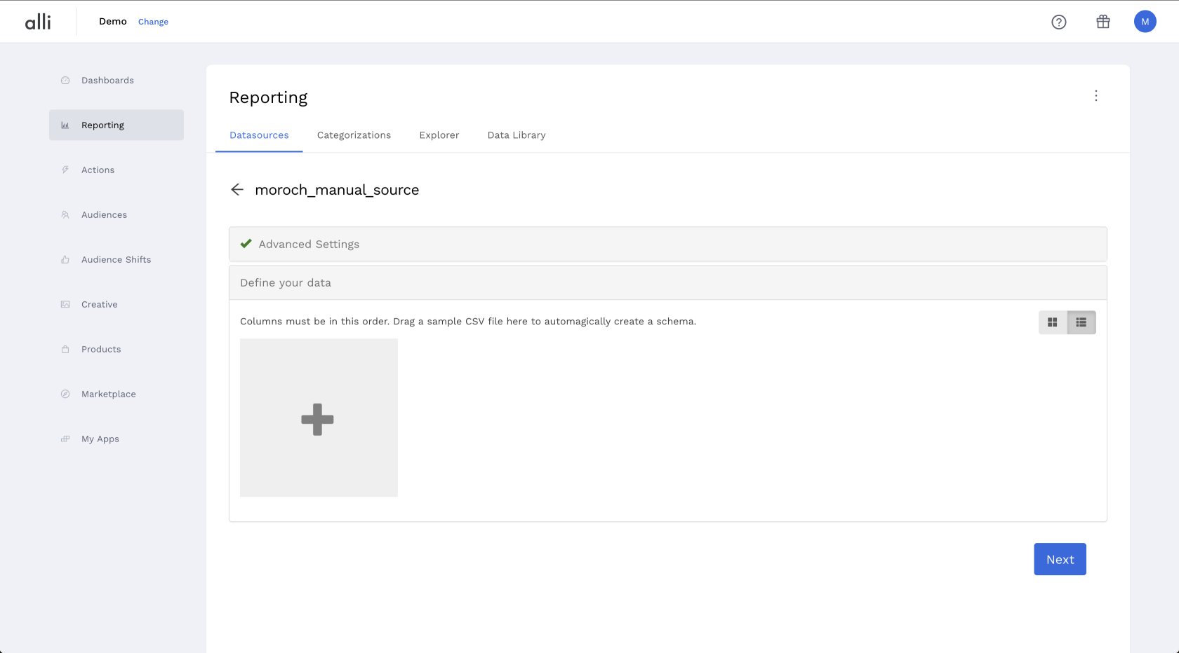
Step 7
Once you have named your datasource click Next and you will see the settings of your newly created datasource.

Slide 8
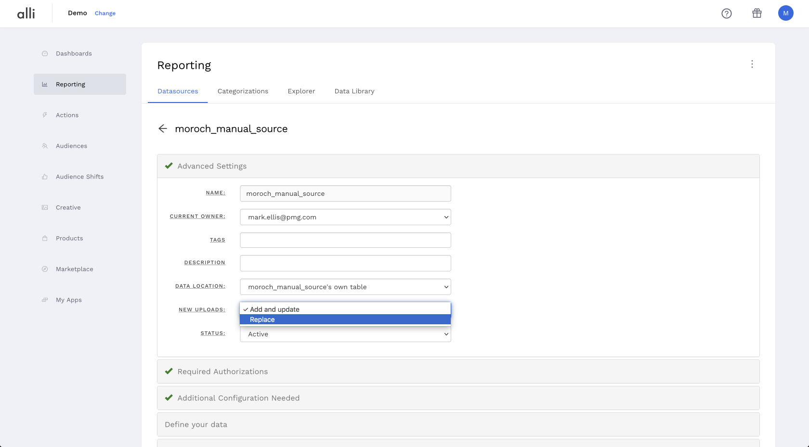
Step 8
Open up Advanced Settings and set "New Uploads" to Replace. This will overwrite any previous data so that you do not have duplicate rows.

Slide 9
Step 9
Definite your data is where you'll configure your datasource schema. If you have a csv with header rows, you can upload here.

Slide 10
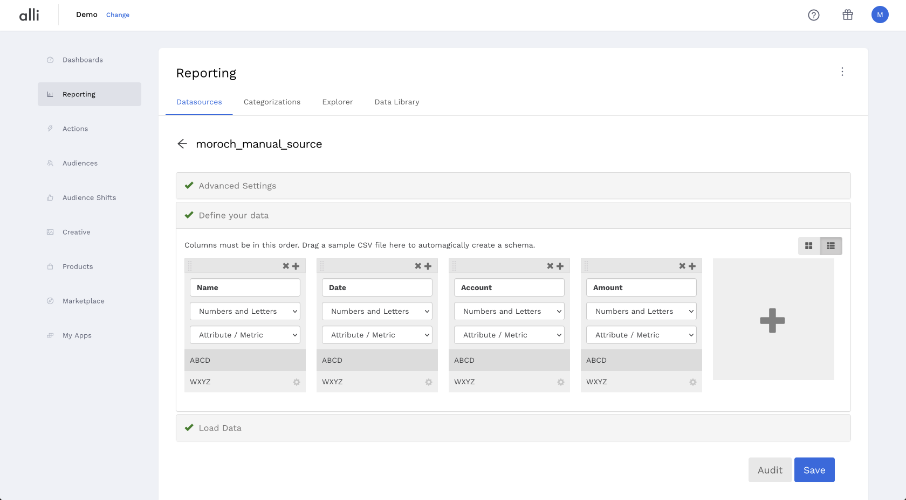
Step 9
If you do not have a csv, you'll click the + symbol to add columns and name them.

Slide 11
Important: regarding no validation
Notice: the default for added columns is Numbers and Letters Attribute / Metric
This is exactly the setting you'll want for a datasource with no validation.

